Slide 1
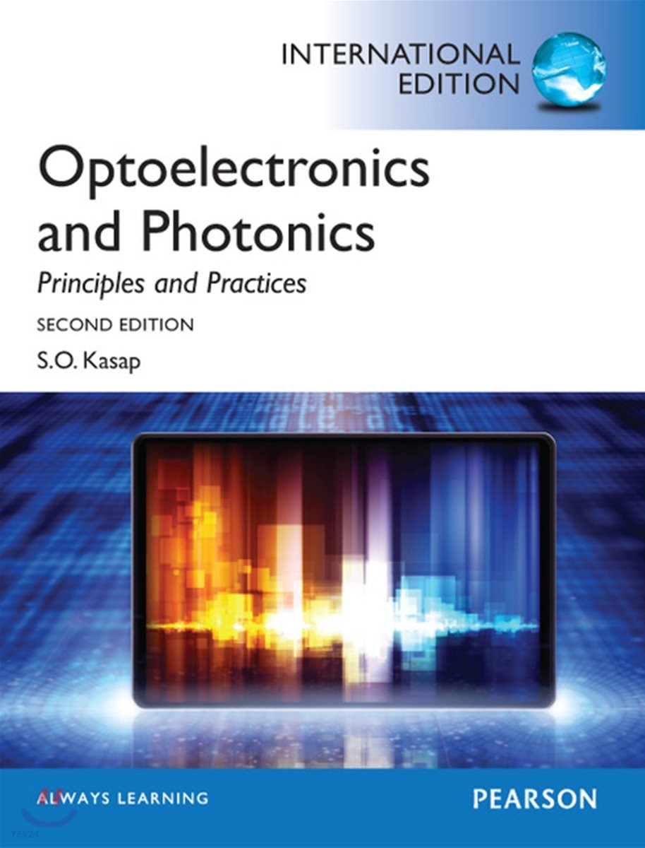
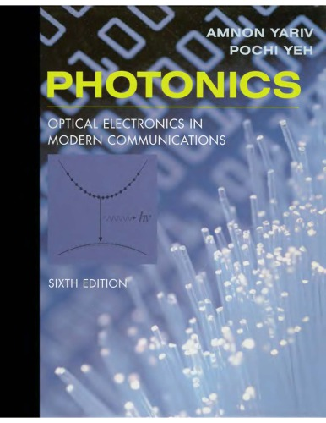

Parameters in Step-index fiber:
Group index. $n_{g}=n−λ\frac{dn}{dλ}$
V-number. $V=\frac{2πa}{λ}\sqrt{n_{1}^{2}−n_{2}^{2}}$
Normalized cutoff frequency. $V_{cutoff}=\frac{2πa}{λ_{c}}\sqrt{n_{1}^{2}−n_{2}^{2}}$
Effective index. $n_{eff}=\frac{cβ}{ω}$
Material dispersion coefficient. $D_{m}=−\frac{1}{cλ}\left(λ^{2}\frac{∂^{2}n}{∂λ^{2}}\right)$
Waveguide dispersion coefficient. $D_{w}=−\frac{1}{cλ}\left(λ^{2}\frac{∂^{2}n_{eff}}{∂λ^{2}}\right)$
Kasap, S. O. (2013). Optoelectronics and photonics. Pearson Education UK.
Yariv, A., & Yeh, P. (2007). Photonics: optical electronics in modern communications. Oxford university press.
We will discuss the derivation and physical meaning of theses parameters.

Slide 2
Above parameters are obtained when solving the Helmholtz equation for step-index optical fiber.
Thus, we will see how they are obtained in the following orders:
Derivation of the Helmholtz equation.
Physical insight in the Helmholtz equation.
Derivation of the energy ratio inside of the step-index fiber using the Helmholtz equation.

Slide 3



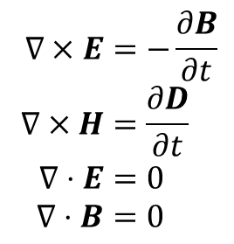


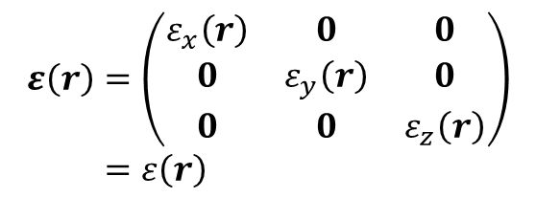



Maxwell’s equations in free space
③ and if the medium is isotropic,
$$∇×E=−\frac{∂B}{∂t} \\ ∇×H=\frac{∂D}{∂t} \\ ∇⋅E=0 \\ ∇⋅B=0$$
$$ε\left(r\right)=\left(\begin{matrix}ε_{x}\left(r\right) & 0 & 0 \\ 0 & ε_{y}\left(r\right) & 0 \\ 0 & 0 & ε_{z}\left(r\right)\end{matrix}\right) \\ =ε\left(r\right)$$
④ and if the medium is homogeneous,
① If the medium is linear,
$$ε\left(r\right)=ε_{0}\left(1+χ_{0}\right)=ε_{r}ε_{0}=ε$$
$$D=ε_{0}E+P=ε_{0}E+ε_{0}χ\left(r,t\right)E=ε\left(r,t\right)E$$
$$D=εE$$
⑤ and if the medium is non-magnetic,
② and if the medium is non-dispersive,
$$χ\left(r,t\right)=χ\left(r\right)$$
$$B=μ_{0}\left(H+M\right)$$
in other words,
$$M=χ_{m}\left(r,t\right)H$$
$$ε\left(r,t\right)=ε\left(r\right)$$
$$χ_{m}\left(r,t\right)=0$$
$$B=μ_{0}H$$

Slide 4
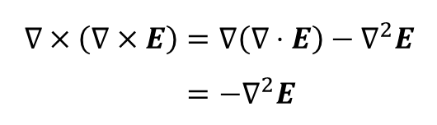
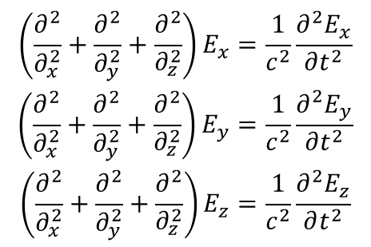
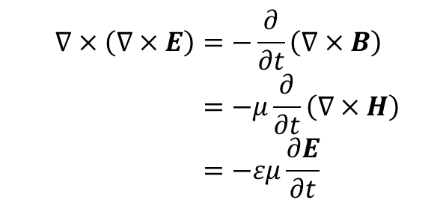
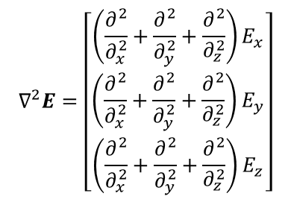

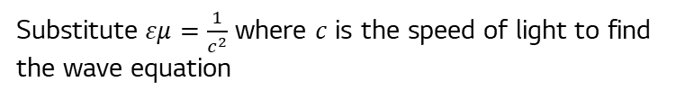
Maxwell’s equations in free space
Then the vector Laplacian, the left-hand side of the wave equation in cartesian coordinate, is equal to
Applying curl on both sides of the Faraday’s law,
$$∇^{2}E=\left[\begin{aligned}\left(\frac{∂^{2}}{∂_{x}^{2}}+\frac{∂^{2}}{∂_{y}^{2}}+\frac{∂^{2}}{∂_{z}^{2}}\right)E_{x} \\ \left(\frac{∂^{2}}{∂_{x}^{2}}+\frac{∂^{2}}{∂_{y}^{2}}+\frac{∂^{2}}{∂_{z}^{2}}\right)E_{y} \\ \left(\frac{∂^{2}}{∂_{x}^{2}}+\frac{∂^{2}}{∂_{y}^{2}}+\frac{∂^{2}}{∂_{z}^{2}}\right)E_{z}\end{aligned}\right]$$
$$∇×\left(∇×E\right)=−\frac{∂}{∂t}\left(∇×B\right) \\ =−μ\frac{∂}{∂t}\left(∇×H\right) \\ =−εμ\frac{∂E}{∂t}$$
from the vector identity,
Then the wave equation becomes
$$∇×\left(∇×E\right)=∇\left(∇⋅E\right)−∇^{2}E \\ =−∇^{2}E$$
$$\begin{aligned}\left(\frac{∂^{2}}{∂_{x}^{2}}+\frac{∂^{2}}{∂_{y}^{2}}+\frac{∂^{2}}{∂_{z}^{2}}\right)E_{x}=\frac{1}{c^{2}}\frac{∂^{2}E_{x}}{∂t^{2}} \\ \left(\frac{∂^{2}}{∂_{x}^{2}}+\frac{∂^{2}}{∂_{y}^{2}}+\frac{∂^{2}}{∂_{z}^{2}}\right)E_{y}=\frac{1}{c^{2}}\frac{∂^{2}E_{y}}{∂t^{2}} \\ \left(\frac{∂^{2}}{∂_{x}^{2}}+\frac{∂^{2}}{∂_{y}^{2}}+\frac{∂^{2}}{∂_{z}^{2}}\right)E_{z}=\frac{1}{c^{2}}\frac{∂^{2}E_{z}}{∂t^{2}}\end{aligned}$$
Substitute $εμ=\frac{1}{c^{2}}$ where $c$ is the speed of light to find the wave equation
$∇^{2}E=\frac{1}{c^{2}}$ $\frac{∂^{2}E}{∂t^{2}}$

Slide 5


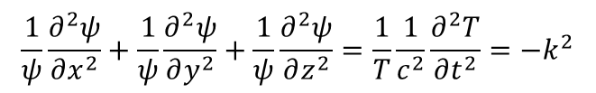

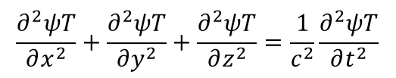

All components of the $E$ and $H$ field have the same form. Thus, we will substitute $x,y,z→i$.
To use the separation of variables, we assume the factored form for $E_{i}$.
$$E_{i}\left(x,y,z,t\right)=ψ\left(x,y,z\right)T\left(t\right)$$
Substituting this into the first equation, we have
$$\frac{∂^{2}ψT}{∂x^{2}}+\frac{∂^{2}ψT}{∂y^{2}}+\frac{∂^{2}ψT}{∂z^{2}}=\frac{1}{c^{2}}\frac{∂^{2}ψT}{∂t^{2}}$$
Now divide by $ψT$ (it’s okay to assume $ψT≠0$ because we don’t want a trivial solution), and we have
$$\frac{1}{ψ}\frac{∂^{2}ψ}{∂x^{2}}+\frac{1}{ψ}\frac{∂^{2}ψ}{∂y^{2}}+\frac{1}{ψ}\frac{∂^{2}ψ}{∂z^{2}}=\frac{1}{T}\frac{1}{c^{2}}\frac{∂^{2}T}{∂t^{2}}=−k^{2}$$
where $k$ is an arbitrary constant. From the last equality, we have
$$\frac{∂^{2}T}{∂t^{2}}=−{c^{2}k}^{2}T$$
$$T\left(t\right)=e^{±iωt}$$
where $ω=ck$.

Slide 6







The equation on the left side is,
$$\frac{1}{ψ}\frac{∂^{2}ψ}{∂x^{2}}+\frac{1}{ψ}\frac{∂^{2}ψ}{∂y^{2}}+\frac{1}{ψ}\frac{∂^{2}ψ}{∂z^{2}}=−k^{2}$$
For spatial variables, we put transversal derivatives into $∇_{⊥}$.
$$\frac{∂^{2}}{∂x^{2}}+\frac{∂^{2}}{∂y^{2}}=∇_{⊥}⋅∇_{⊥}=∇_{⊥}^{2}$$
It is then simplified as,
$$\frac{1}{ψ}∇_{⊥}^{2}ψ+\frac{1}{ψ}\frac{∂^{2}ψ}{∂z^{2}}=−k^{2}$$
If we introduce another constant $β$,
$$\frac{1}{ψ}\frac{∂^{2}ψ}{∂z^{2}}=−k^{2}−\frac{1}{ψ}∇_{⊥}^{2}ψ=−β^{2}$$
Assume the factored form of $ψ$ such that
$$ψ\left(x,y,z\right)=P\left(x,y\right)Q\left(z\right)$$

Slide 7





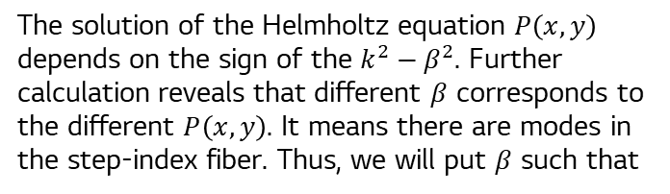







Inserting to the above equation, we get
The solution of the Helmholtz equation $P\left(x,y\right)$ depends on the sign of the $k^{2}−β^{2}$. Further calculation reveals that different $β$ corresponds to the different $P\left(x,y\right)$. It means there are modes in the step-index fiber. Thus, we will put $β$ such that
$$\frac{1}{PQ}\frac{∂^{2}PQ}{∂z^{2}}=−β^{2}$$
Since $P$ is not dependent on $z$ and $P≠0$ for non-trivial solutions,
$$β→β_{m}$$
where subscript $m$ denotes a mode of the field.
$$\frac{1}{Q}\frac{∂^{2}Q}{∂z^{2}}=−β^{2}$$
$$Q\left(z\right)=e^{±iβz}$$
$E_{y}$ can be rewritten as the following form:
$$E_{y}\left(x,y,z,t\right)=P_{m}\left(x,y\right)e^{i\left(±β_{m}z±ωt\right)}$$
For $P$, the equation is,
Without loss of generality, we choose the sign of the phase as:
$$−\frac{1}{P}∇_{⊥}^{2}P=k^{2}−β^{2}$$
$$E_{y}\left(x,y,z,t\right)=P_{m}\left(x,y\right)e^{i\left(β_{m}z−ωt\right)}$$
$$∇_{⊥}^{2}P=−\left(k^{2}−β^{2}\right)P$$
We now have the Helmholtz equation.
Note that the Helmholtz equation can be rewritten in cylindrical coordinate such that
$$∇_{⊥}^{2}P\left(r,φ\right)+\left(k^{2}−β_{m}^{2}\right)P_{m}\left(r,φ\right)=0$$
$$∇_{⊥}^{2}P\left(x,y\right)+\left(k^{2}−β^{2}\right)P\left(x,y\right)=0$$

Slide 8


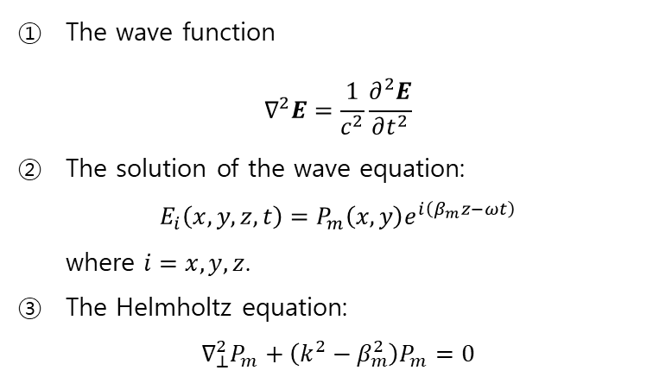
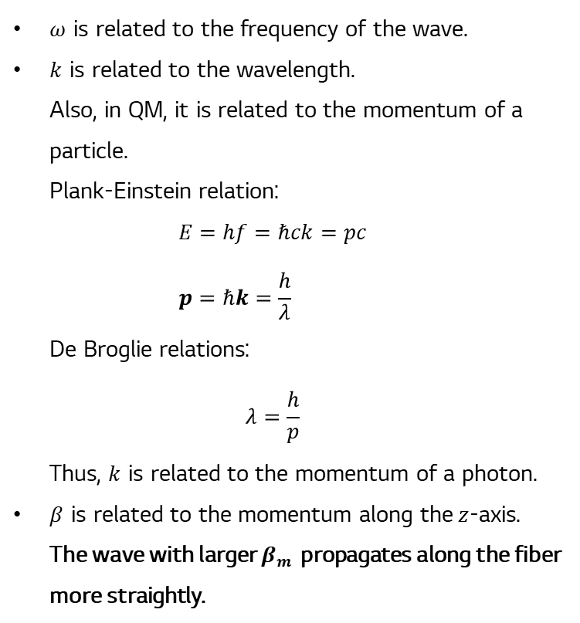
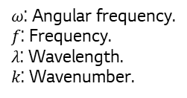

The wave function $∇^{2}E=\frac{1}{c^{2}}\frac{∂^{2}E}{∂t^{2}}$
The solution of the wave equation: $E_{i}\left(x,y,z,t\right)=P_{m}\left(x,y\right)e^{i\left(β_{m}z−ωt\right)}$ where $i=x,y,z$.
The Helmholtz equation: $∇_{⊥}^{2}P_{m}+\left(k^{2}−β_{m}^{2}\right)P_{m}=0$
$ω$ is related to the frequency of the wave.
$k$ is related to the wavelength. Also, in QM, it is related to the momentum of a particle. Plank-Einstein relation: $E=hf=ℏck=pc$ $p=ℏk=\frac{h}{λ}$ De Broglie relations: $λ=\frac{h}{p}$ Thus, $k$ is related to the momentum of a photon.
$β$ is related to the momentum along the$z$-axis. The wave with larger $β_{m}$ propagates along the fiber more straightly.
What is the physical meaning of $ω,k$ and $β$?
$$e^{−iωt}→ω=\frac{2π}{T}=2πf=\frac{2πc}{λ}=ck$$
$$k=\frac{c}{λ}=n\frac{c}{λ_{0}}$$
$ω$: Angular frequency.
$f$: Frequency.
$λ$: Wavelength.
$k$: Wavenumber.

Slide 9
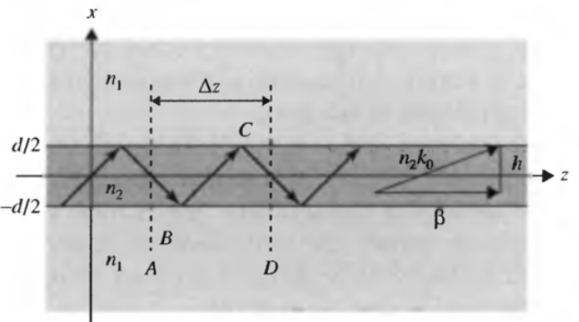
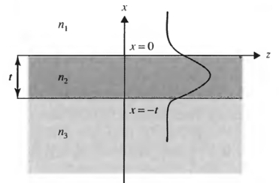
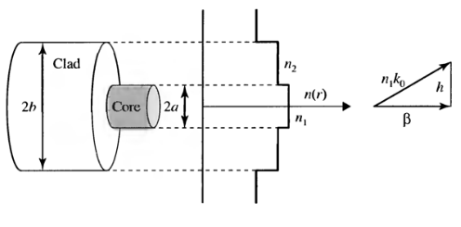
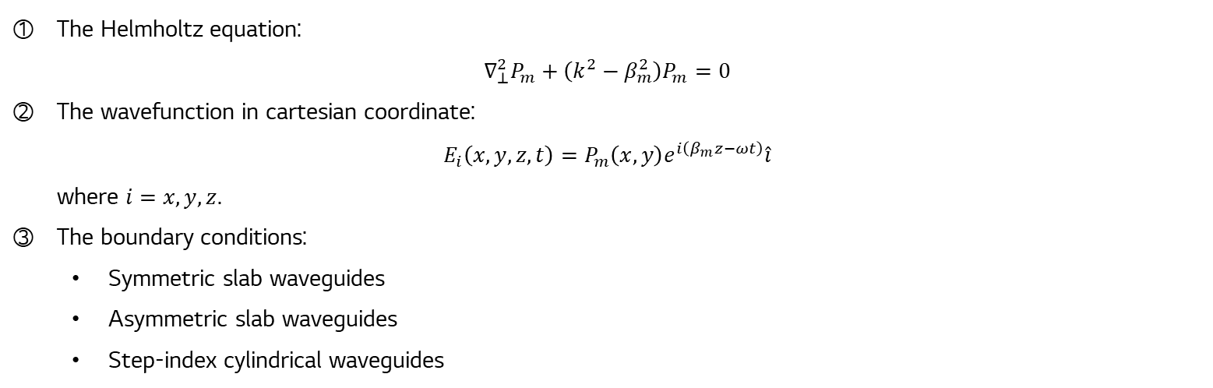
The Helmholtz equation: $∇_{⊥}^{2}P_{m}+\left(k^{2}−β_{m}^{2}\right)P_{m}=0$
The wavefunction in cartesian coordinate: $E_{i}\left(x,y,z,t\right)=P_{m}\left(x,y\right)e^{i\left(β_{m}z−ωt\right)}\hat{i}$ where $i=x,y,z$.
The boundary conditions:
Symmetric slab waveguides
Asymmetric slab waveguides
Step-index cylindrical waveguides
Symmetric slab waveguides
Asymmetric slab waveguides
Step-index cylindrical waveguides

Slide 10

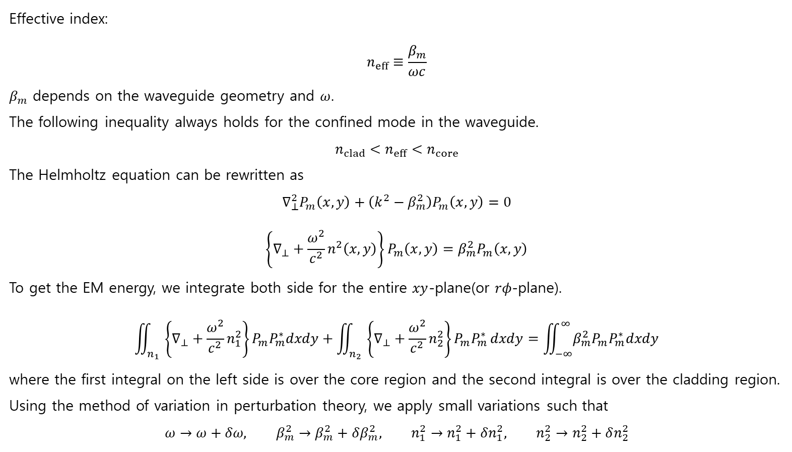

Effective index: $$n_{eff}≡\frac{β_{m}}{ωc}$$
$β_{m}$ depends on the waveguide geometry and $ω$.
The following inequality always holds for the confined mode in the waveguide. $$n_{clad}<n_{eff}<n_{core}$$
The Helmholtz equation can be rewritten as $$∇_{⊥}^{2}P_{m}\left(x,y\right)+\left(k^{2}−β_{m}^{2}\right)P_{m}\left(x,y\right)=0$$
$$\left\{∇_{⊥}+\frac{ω^{2}}{c^{2}}n^{2}\left(x,y\right)\right\}P_{m}\left(x,y\right)=β_{m}^{2}P_{m}\left(x,y\right)$$
To get the EM energy, we integrate both side for the entire $xy$-plane(or $rφ$-plane).
$$\iint_{n_{1}}{\left\{∇_{⊥}+\frac{ω^{2}}{c^{2}}n_{1}^{2}\right\}P_{m}P_{m}^{∗}dxdy}+\iint_{n_{2}}{\left\{∇_{⊥}+\frac{ω^{2}}{c^{2}}n_{2}^{2}\right\}P_{m}P_{m}^{∗}}dxdy=\iint_{−∞}^{∞}{β_{m}^{2}P_{m}P_{m}^{∗}dxdy}$$
where the first integral on the left side is over the core region and the second integral is over the cladding region.
Using the method of variation in perturbation theory, we apply small variations such that
$$ω→ω+δω, β_{m}^{2}→β_{m}^{2}+δβ_{m}^{2}, n_{1}^{2}→n_{1}^{2}+δn_{1}^{2}, n_{2}^{2}→n_{2}^{2}+δn_{2}^{2}$$
Integral over the cross section!
$$n_{clad}=n_{2}$$
$n_{core}=n_{1}$

Slide 11
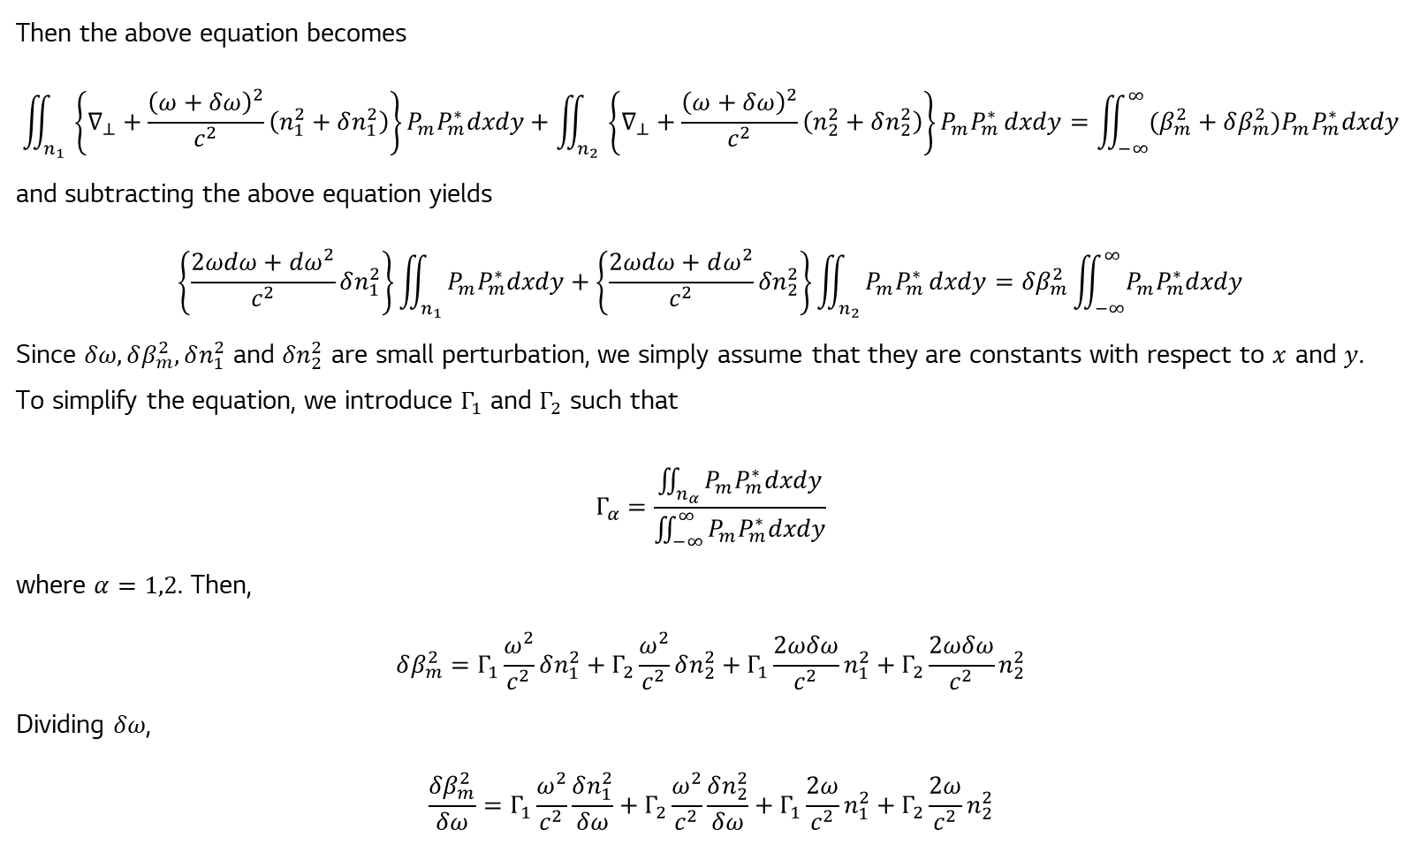
Then the above equation becomes
$$\iint_{n_{1}}{\left\{∇_{⊥}+\frac{{\left(ω+δω\right)}^{2}}{c^{2}}\left(n_{1}^{2}+δn_{1}^{2}\right)\right\}P_{m}P_{m}^{∗}dxdy}+\iint_{n_{2}}{\left\{∇_{⊥}+\frac{{\left(ω+δω\right)}^{2}}{c^{2}}\left(n_{2}^{2}+δn_{2}^{2}\right)\right\}P_{m}P_{m}^{∗}}dxdy=\iint_{−∞}^{∞}{(β_{m}^{2}+δβ_{m}^{2})P_{m}P_{m}^{∗}dxdy}$$
and subtracting the above equation yields
$$\left\{\frac{2ωdω+dω^{2}}{c^{2}}δn_{1}^{2}\right\}\iint_{n_{1}}{P_{m}P_{m}^{∗}dxdy}+\left\{\frac{2ωdω+dω^{2}}{c^{2}}δn_{2}^{2}\right\}\iint_{n_{2}}{P_{m}P_{m}^{∗}}dxdy=δβ_{m}^{2}\iint_{−∞}^{∞}{P_{m}P_{m}^{∗}dxdy}$$
Since $δω,δβ_{m}^{2},δn_{1}^{2}$ and $δn_{2}^{2}$ are small perturbation, we simply assume that they are constants with respect to $x$ and $y$.
To simplify the equation, we introduce $Γ_{1}$ and $Γ_{2}$ such that
$$Γ_{α}=\frac{\iint_{n_{α}}{P_{m}P_{m}^{∗}dxdy}}{\iint_{−∞}^{∞}{P_{m}P_{m}^{∗}dxdy}}$$
where $α=1,2$. Then,
$$δβ_{m}^{2}=Γ_{1}\frac{ω^{2}}{c^{2}}δn_{1}^{2}+Γ_{2}\frac{ω^{2}}{c^{2}}δn_{2}^{2}+Γ_{1}\frac{2ωδω}{c^{2}}n_{1}^{2}+Γ_{2}\frac{2ωδω}{c^{2}}n_{2}^{2}$$
Dividing $δω$,
$$\frac{δβ_{m}^{2}}{δω}=Γ_{1}\frac{ω^{2}}{c^{2}}\frac{δn_{1}^{2}}{δω}+Γ_{2}\frac{ω^{2}}{c^{2}}\frac{δn_{2}^{2}}{δω}+Γ_{1}\frac{2ω}{c^{2}}n_{1}^{2}+Γ_{2}\frac{2ω}{c^{2}}n_{2}^{2}$$

Slide 12
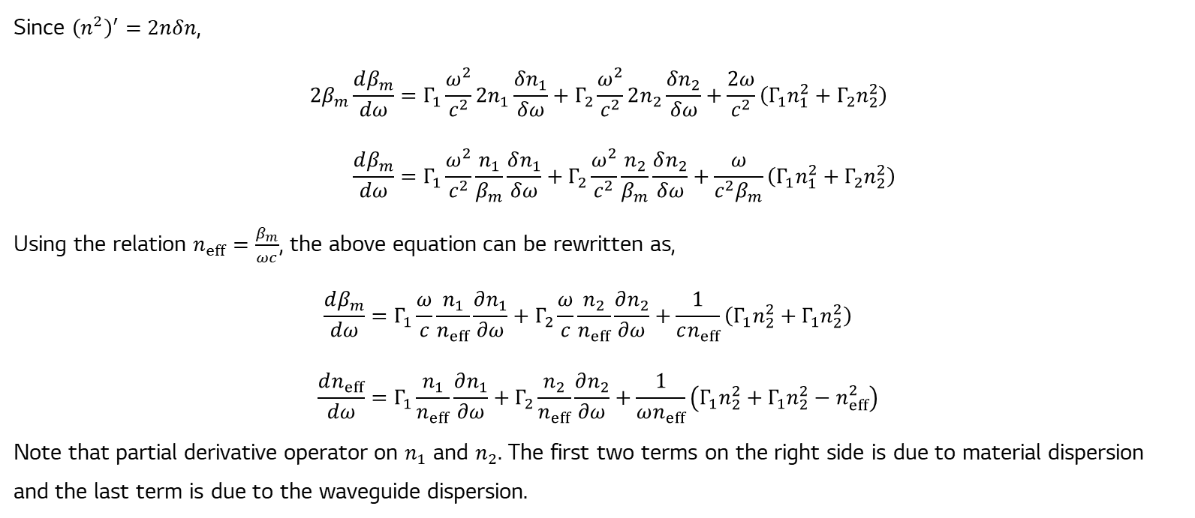
Since ${\left(n^{2}\right)}^{′}=2nδn$,
$$2β_{m}\frac{dβ_{m}}{dω}=Γ_{1}\frac{ω^{2}}{c^{2}}2n_{1}\frac{δn_{1}}{δω}+Γ_{2}\frac{ω^{2}}{c^{2}}2n_{2}\frac{δn_{2}}{δω}+\frac{2ω}{c^{2}}\left(Γ_{1}n_{1}^{2}+Γ_{2}n_{2}^{2}\right) \\ \frac{dβ_{m}}{dω}=Γ_{1}\frac{ω^{2}}{c^{2}}\frac{n_{1}}{β_{m}}\frac{δn_{1}}{δω}+Γ_{2}\frac{ω^{2}}{c^{2}}\frac{n_{2}}{β_{m}}\frac{δn_{2}}{δω}+\frac{ω}{c^{2}β_{m}}\left(Γ_{1}n_{1}^{2}+Γ_{2}n_{2}^{2}\right)$$
Using the relation $n_{eff}=\frac{β_{m}}{ωc}$, the above equation can be rewritten as,
$$\frac{dβ_{m}}{dω}=Γ_{1}\frac{ω}{c}\frac{n_{1}}{n_{eff}}\frac{∂n_{1}}{∂ω}+Γ_{2}\frac{ω}{c}\frac{n_{2}}{n_{eff}}\frac{∂n_{2}}{∂ω}+\frac{1}{cn_{eff}}\left(Γ_{1}n_{2}^{2}+Γ_{1}n_{2}^{2}\right) \\ \frac{dn_{eff}}{dω}=Γ_{1}\frac{n_{1}}{n_{eff}}\frac{∂n_{1}}{∂ω}+Γ_{2}\frac{n_{2}}{n_{eff}}\frac{∂n_{2}}{∂ω}+\frac{1}{ωn_{eff}}\left(Γ_{1}n_{2}^{2}+Γ_{1}n_{2}^{2}−n_{eff}^{2}\right)$$
Note that partial derivative operator on $n_{1}$ and $n_{2}$. The first two terms on the right side is due to material dispersion and the last term is due to the waveguide dispersion.

Slide 13

$$\frac{dn_{eff}}{dω}={\left(\frac{∂n_{eff}}{∂ω}\right)}_{material}+{\left(\frac{∂n_{eff}}{∂ω}\right)}_{waveguide}$$
where
$${\left(\frac{∂n_{eff}}{∂ω}\right)}_{material}=Γ_{1}\frac{n_{1}}{n_{eff}}\frac{∂n_{1}}{∂ω}+Γ_{2}\frac{n_{2}}{n_{eff}}\frac{∂n_{2}}{∂ω}$$
$${\left(\frac{∂n_{eff}}{∂ω}\right)}_{waveguide}=\frac{1}{ωn_{eff}}\left(Γ_{1}n_{2}^{2}+Γ_{1}n_{2}^{2}−n_{eff}^{2}\right)$$
For single-mode silica fibers used in modern optical communications, the clad and core are both made of silica with $n_{1}≈n_{2}$. Thus, we can approximate the above such that,
$${\left(\frac{∂n_{eff}}{∂ω}\right)}_{material}≅\frac{∂n}{∂ω} \\ {\left(\frac{∂n_{eff}}{∂ω}\right)}_{waveguide}≅\frac{1}{ωn_{eff}}\left(n_{2}^{2}+Γ_{1}\left[n_{1}^{2}−n_{2}^{2}\right]−n_{eff}^{2}\right)$$

Slide 14
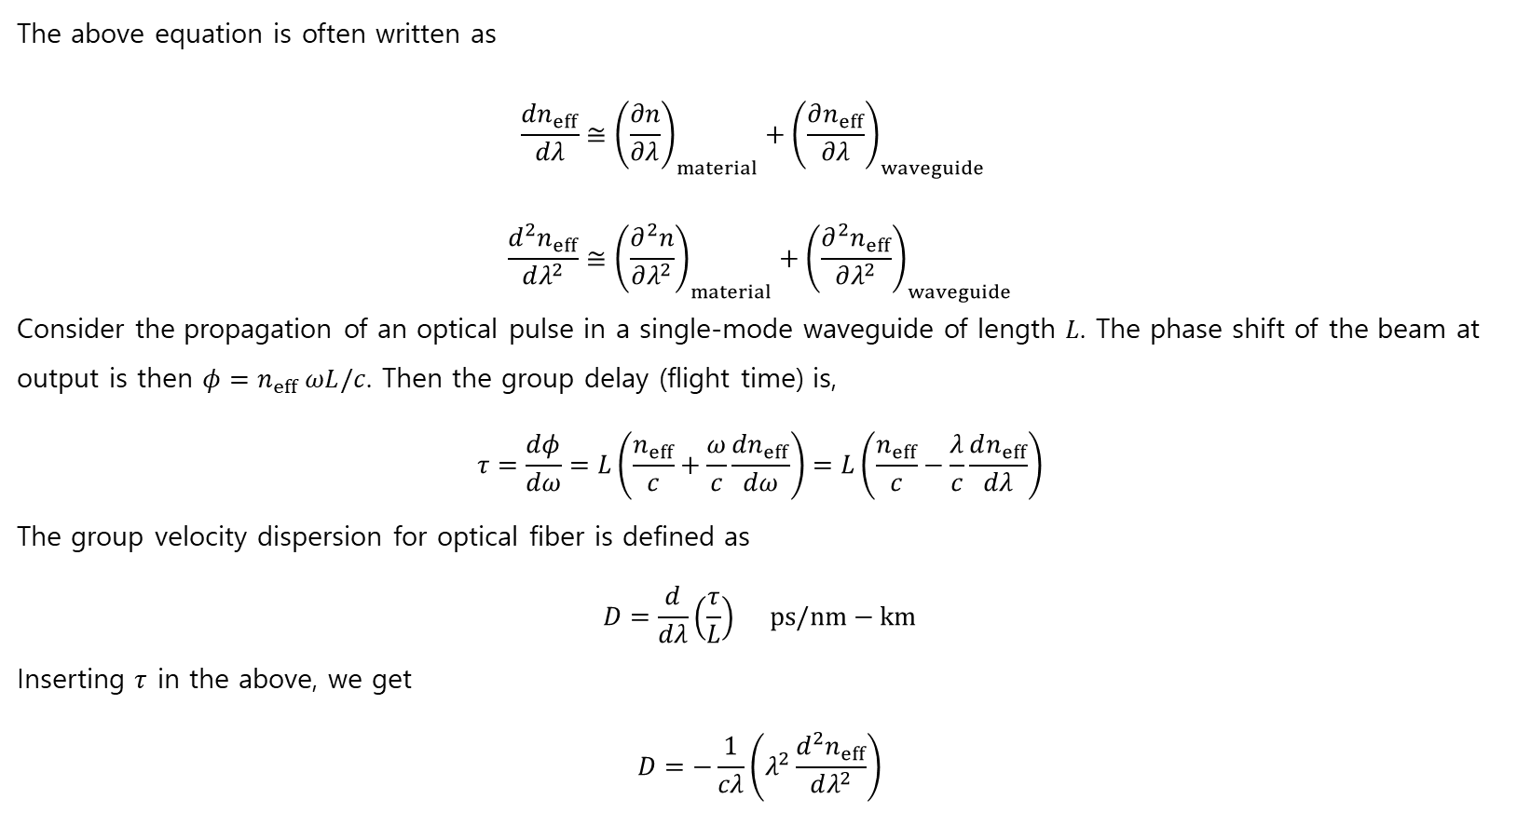
The above equation is often written as
$$\frac{dn_{eff}}{dλ}≅{\left(\frac{∂n}{∂λ}\right)}_{material}+{\left(\frac{∂n_{eff}}{∂λ}\right)}_{waveguide} \\ \frac{d^{2}n_{eff}}{dλ^{2}}≅{\left(\frac{∂^{2}n}{∂λ^{2}}\right)}_{material}+{\left(\frac{∂^{2}n_{eff}}{∂λ^{2}}\right)}_{waveguide}$$
Consider the propagation of an optical pulse in a single-mode waveguide of length $L$. The phase shift of the beam at output is then $φ=n_{eff} ωL/c$. Then the group delay (flight time) is,
$$τ=\frac{dφ}{dω}=L\left(\frac{n_{eff}}{c}+\frac{ω}{c}\frac{dn_{eff}}{dω}\right)=L\left(\frac{n_{eff}}{c}−\frac{λ}{c}\frac{dn_{eff}}{dλ}\right)$$
The group velocity dispersion for optical fiber is defined as
$$D=\frac{d}{dλ}\left(\frac{τ}{L}\right) ps/nm−km$$
Inserting $τ$ in the above, we get
$$D=−\frac{1}{cλ}\left(λ^{2}\frac{d^{2}n_{eff}}{dλ^{2}}\right)$$

Slide 15
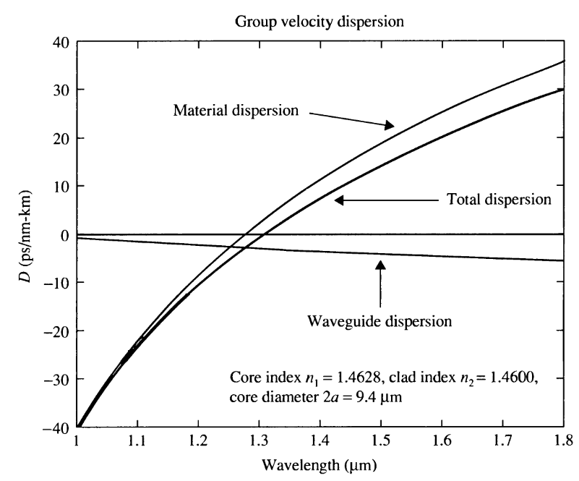
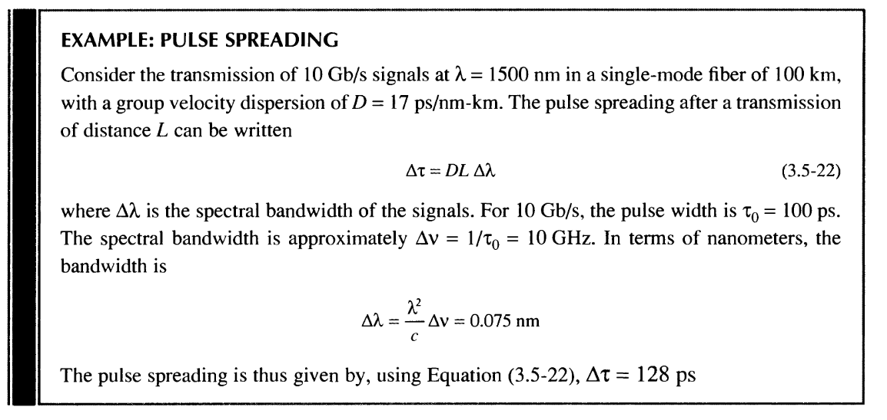
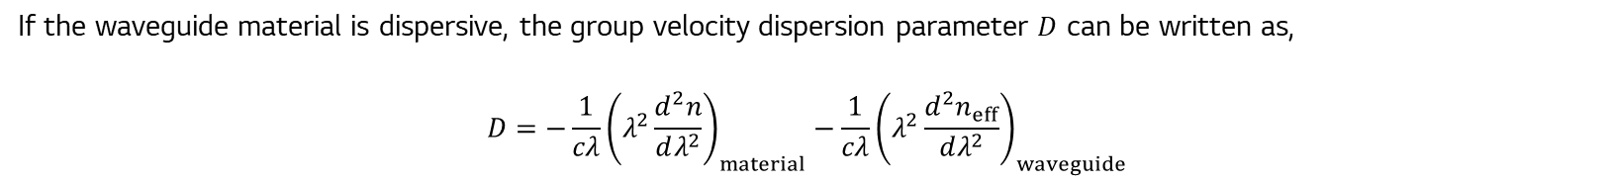

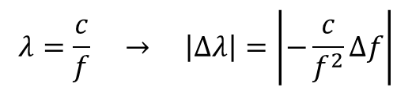
If the waveguide material is dispersive, the group velocity dispersion parameter $D$ can be written as,
$$D=−\frac{1}{cλ}{\left(λ^{2}\frac{d^{2}n}{dλ^{2}}\right)}_{material}−\frac{1}{cλ}{\left(λ^{2}\frac{d^{2}n_{eff}}{dλ^{2}}\right)}_{waveguide}$$
$$λ=\frac{c}{f} → \left|Δλ\right|=\left|−\frac{c}{f^{2}}Δf\right|$$
What is the difference between $n_{eff}$ and $n_{g}$?

Slide 16
Gaussian wave.
Symmetric slab waveguides.
Asymmetric slab waveguides.
Step-index circular dielectric waveguides.
Effective index theory.
Waveguide dispersion in optical fibers.
Attenuation in Silica fibers.
Yariv, A., & Yeh, P. (2007). Photonics: optical electronics in modern communications. Oxford university press.

Slide 18
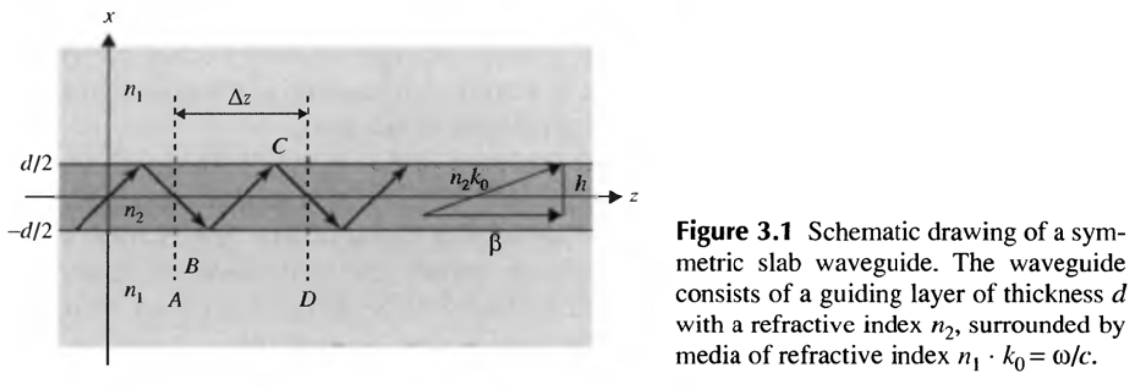

Slide 19




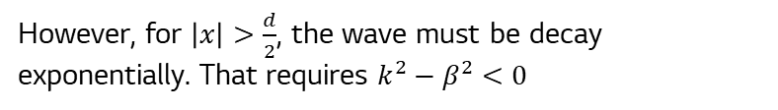
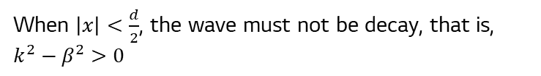
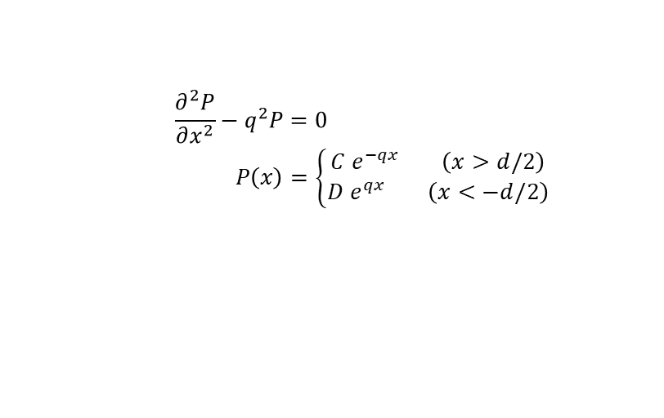
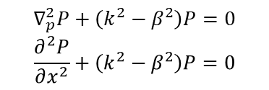

We can further simplify Maxwell’s equation using the symmetry along the $y$-axis.
However, for $\left|x\right|>\frac{d}{2}$, the wave must be decay exponentially. That requires $k^{2}−β^{2}<0$
$$E_{y}\left(x,y,z,t\right)=P\left(x,y\right)e^{i\left(±βz±ωt\right)} \\ =P\left(x\right)e^{i\left(±βz±ωt\right)}$$
$$β^{2}−k^{2}=q^{2}>0$$
$$\frac{∂^{2}P}{∂x^{2}}−q^{2}P=0 \\ P\left(x\right)=\left\{\begin{aligned}C e^{−qx} \left(x>d/2\right) \\ D e^{qx} \left(x<−d/2\right)\end{aligned}\right.$$
$$∇_{p}^{2}P+\left(k^{2}−β^{2}\right)P=0 \\ \frac{∂^{2}P}{∂x^{2}}+\left(k^{2}−β^{2}\right)P=0$$
When $\left|x\right|<\frac{d}{2}$, the wave must not be decay, that is, $k^{2}−β^{2}>0$
$$k^{2}−β^{2}=h^{2}>0$$
$$\frac{∂^{2}P}{∂x^{2}}+h^{2}P=0 \\ P\left(x\right)=A\sin{hx}+B\cos{hx}$$

Slide 20
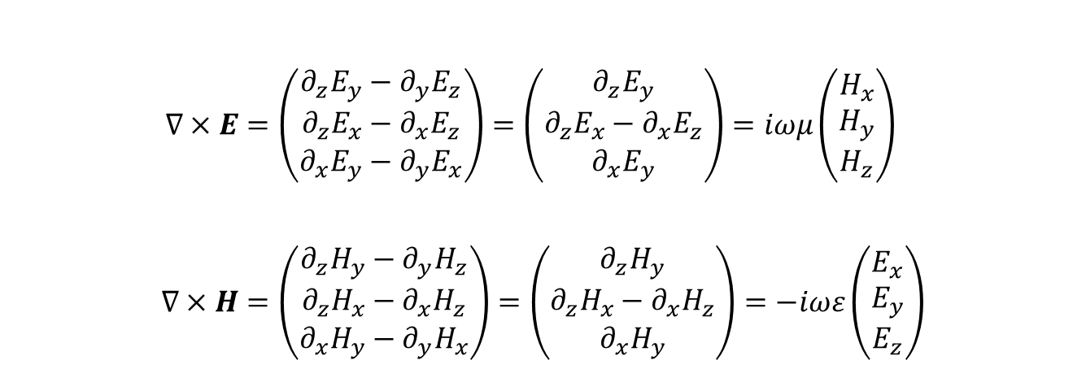

Since the wave is time-harmonic, Maxwell’s equations become
$$∇×E=−\frac{∂B}{∂t}=iωμH \\ ∇×H=\frac{∂D}{∂t}=−iωεE$$
$$∇×E=\left(\begin{aligned}∂_{z}E_{y}−∂_{y}E_{z} \\ ∂_{z}E_{x}−∂_{x}E_{z} \\ ∂_{x}E_{y}−∂_{y}E_{x}\end{aligned}\right)=\left(\begin{aligned}∂_{z}E_{y} \\ ∂_{z}E_{x}−∂_{x}E_{z} \\ ∂_{x}E_{y}\end{aligned}\right)=iωμ\left(\begin{aligned}H_{x} \\ H_{y} \\ H_{z}\end{aligned}\right) \\ ∇×H=\left(\begin{aligned}∂_{z}H_{y}−∂_{y}H_{z} \\ ∂_{z}H_{x}−∂_{x}H_{z} \\ ∂_{x}H_{y}−∂_{y}H_{x}\end{aligned}\right)=\left(\begin{aligned}∂_{z}H_{y} \\ ∂_{z}H_{x}−∂_{x}H_{z} \\ ∂_{x}H_{y}\end{aligned}\right)=−iωε\left(\begin{aligned}E_{x} \\ E_{y} \\ E_{z}\end{aligned}\right)$$
Due to the symmetry along $y$-axis, we can separate the solution by TE mode and TM mode.

Slide 21

For TE mode, $E_{x}=E_{z}=0$.

